Slide 1

GET and POST Methods
Abdulkarim Albanna
www.facebook/abdulkarimalbanna

Slide 2
Send Data
There are two ways the browser client can send information to the web server.
The GET Method
The POST Method
Notes:
A markup language is a set of tags and/or a set of rules for creating tags that can be embedded in digital text to provide additional information about the text in order to facilitate automated processing of it, including editing and formatting for display or printing.Dec 13, 2006
The browsers we will talk about
There are five major browsers used on desktop today: Chrome, Internet Explorer, Firefox, Safari and Opera. On mobile, the main browsers are Android Browser, iPhone, Opera Mini and Opera Mobile, UC Browser, the Nokia S40/S60 browsers and Chrome–all of which, except for the Opera browsers, are based on WebKit. I will give examples from the open source browsers Firefox and Chrome, and Safari (which is partly open source). According to StatCounter statistics (as of June 2013) Chrome, Firefox and Safari make up around 71% of global desktop browser usage. On mobile, Android Browser, iPhone and Chrome constitute around 54% of usage.
The browser's main functionality
The main function of a browser is to present the web resource you choose, by requesting it from the server and displaying it in the browser window. The resource is usually an HTML document, but may also be a PDF, image, or some other type of content. The location of the resource is specified by the user using a URI (Uniform Resource Identifier).
The way the browser interprets and displays HTML files is specified in the HTML and CSS specifications. These specifications are maintained by the W3C (World Wide Web Consortium) organization, which is the standards organization for the web. For years browsers conformed to only a part of the specifications and developed their own extensions. That caused serious compatibility issues for web authors. Today most of the browsers more or less conform to the specifications.

Slide 3

The GET Method
The GET method sends the encoded user information appended to the page request. The page and the encoded information are separated by the ? character.
Notes:
A markup language is a set of tags and/or a set of rules for creating tags that can be embedded in digital text to provide additional information about the text in order to facilitate automated processing of it, including editing and formatting for display or printing.Dec 13, 2006
The browsers we will talk about
There are five major browsers used on desktop today: Chrome, Internet Explorer, Firefox, Safari and Opera. On mobile, the main browsers are Android Browser, iPhone, Opera Mini and Opera Mobile, UC Browser, the Nokia S40/S60 browsers and Chrome–all of which, except for the Opera browsers, are based on WebKit. I will give examples from the open source browsers Firefox and Chrome, and Safari (which is partly open source). According to StatCounter statistics (as of June 2013) Chrome, Firefox and Safari make up around 71% of global desktop browser usage. On mobile, Android Browser, iPhone and Chrome constitute around 54% of usage.
The browser's main functionality
The main function of a browser is to present the web resource you choose, by requesting it from the server and displaying it in the browser window. The resource is usually an HTML document, but may also be a PDF, image, or some other type of content. The location of the resource is specified by the user using a URI (Uniform Resource Identifier).
The way the browser interprets and displays HTML files is specified in the HTML and CSS specifications. These specifications are maintained by the W3C (World Wide Web Consortium) organization, which is the standards organization for the web. For years browsers conformed to only a part of the specifications and developed their own extensions. That caused serious compatibility issues for web authors. Today most of the browsers more or less conform to the specifications.

Slide 4
The GET Method
• The GET method is restricted to send up to 1024 characters only.
• Never use GET method if you have password or other sensitive information to be sent
to the server.
• GET can't be used to send binary data, like images or word documents, to the server.
• The data sent by GET method can be accessed using QUERY_STRING environment
variable.
• The PHP provides $_GET associative array to access all the sent information using
GET method.
Notes:
A markup language is a set of tags and/or a set of rules for creating tags that can be embedded in digital text to provide additional information about the text in order to facilitate automated processing of it, including editing and formatting for display or printing.Dec 13, 2006
The browsers we will talk about
There are five major browsers used on desktop today: Chrome, Internet Explorer, Firefox, Safari and Opera. On mobile, the main browsers are Android Browser, iPhone, Opera Mini and Opera Mobile, UC Browser, the Nokia S40/S60 browsers and Chrome–all of which, except for the Opera browsers, are based on WebKit. I will give examples from the open source browsers Firefox and Chrome, and Safari (which is partly open source). According to StatCounter statistics (as of June 2013) Chrome, Firefox and Safari make up around 71% of global desktop browser usage. On mobile, Android Browser, iPhone and Chrome constitute around 54% of usage.
The browser's main functionality
The main function of a browser is to present the web resource you choose, by requesting it from the server and displaying it in the browser window. The resource is usually an HTML document, but may also be a PDF, image, or some other type of content. The location of the resource is specified by the user using a URI (Uniform Resource Identifier).
The way the browser interprets and displays HTML files is specified in the HTML and CSS specifications. These specifications are maintained by the W3C (World Wide Web Consortium) organization, which is the standards organization for the web. For years browsers conformed to only a part of the specifications and developed their own extensions. That caused serious compatibility issues for web authors. Today most of the browsers more or less conform to the specifications.

Slide 5
The POST Method
The POST method transfers information via HTTP headers. The information is encoded as described in case of GET method and put into a header called QUERY_STRING.
Notes:
A markup language is a set of tags and/or a set of rules for creating tags that can be embedded in digital text to provide additional information about the text in order to facilitate automated processing of it, including editing and formatting for display or printing.Dec 13, 2006
The browsers we will talk about
There are five major browsers used on desktop today: Chrome, Internet Explorer, Firefox, Safari and Opera. On mobile, the main browsers are Android Browser, iPhone, Opera Mini and Opera Mobile, UC Browser, the Nokia S40/S60 browsers and Chrome–all of which, except for the Opera browsers, are based on WebKit. I will give examples from the open source browsers Firefox and Chrome, and Safari (which is partly open source). According to StatCounter statistics (as of June 2013) Chrome, Firefox and Safari make up around 71% of global desktop browser usage. On mobile, Android Browser, iPhone and Chrome constitute around 54% of usage.
The browser's main functionality
The main function of a browser is to present the web resource you choose, by requesting it from the server and displaying it in the browser window. The resource is usually an HTML document, but may also be a PDF, image, or some other type of content. The location of the resource is specified by the user using a URI (Uniform Resource Identifier).
The way the browser interprets and displays HTML files is specified in the HTML and CSS specifications. These specifications are maintained by the W3C (World Wide Web Consortium) organization, which is the standards organization for the web. For years browsers conformed to only a part of the specifications and developed their own extensions. That caused serious compatibility issues for web authors. Today most of the browsers more or less conform to the specifications.

Slide 6
The POST Method
The POST method does not have any restriction on data size to be sent.
The POST method can be used to send ASCII as well as binary data.
The data sent by POST method goes through HTTP header so security depends onHTTP protocol. By using Secure HTTP you can make sure that your information is secure.
The PHP provides $_POST associative array to access all the sent information
using POST method.
Notes:
A markup language is a set of tags and/or a set of rules for creating tags that can be embedded in digital text to provide additional information about the text in order to facilitate automated processing of it, including editing and formatting for display or printing.Dec 13, 2006
The browsers we will talk about
There are five major browsers used on desktop today: Chrome, Internet Explorer, Firefox, Safari and Opera. On mobile, the main browsers are Android Browser, iPhone, Opera Mini and Opera Mobile, UC Browser, the Nokia S40/S60 browsers and Chrome–all of which, except for the Opera browsers, are based on WebKit. I will give examples from the open source browsers Firefox and Chrome, and Safari (which is partly open source). According to StatCounter statistics (as of June 2013) Chrome, Firefox and Safari make up around 71% of global desktop browser usage. On mobile, Android Browser, iPhone and Chrome constitute around 54% of usage.
The browser's main functionality
The main function of a browser is to present the web resource you choose, by requesting it from the server and displaying it in the browser window. The resource is usually an HTML document, but may also be a PDF, image, or some other type of content. The location of the resource is specified by the user using a URI (Uniform Resource Identifier).
The way the browser interprets and displays HTML files is specified in the HTML and CSS specifications. These specifications are maintained by the W3C (World Wide Web Consortium) organization, which is the standards organization for the web. For years browsers conformed to only a part of the specifications and developed their own extensions. That caused serious compatibility issues for web authors. Today most of the browsers more or less conform to the specifications.

Slide 7

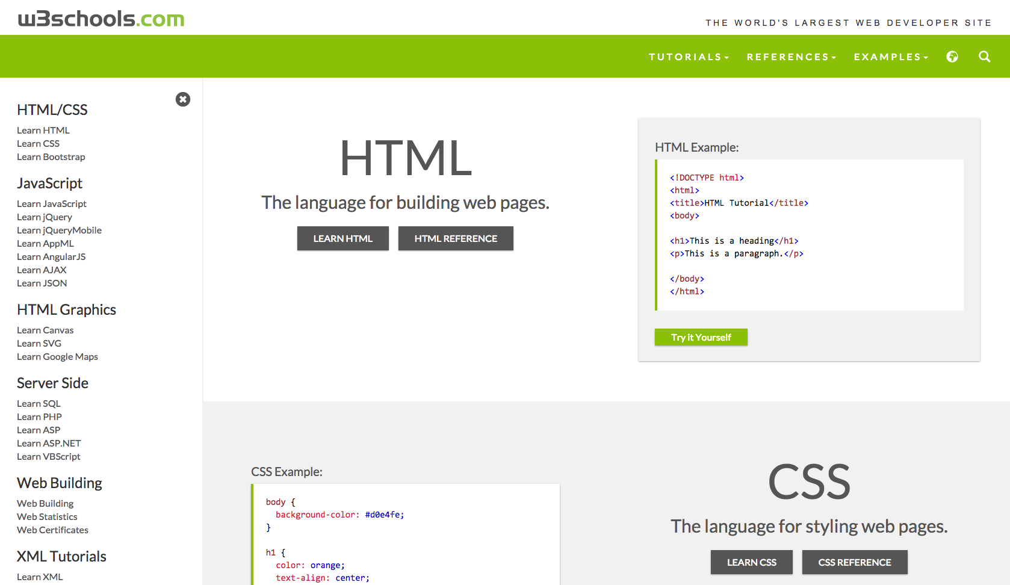
References...

